Slide 1
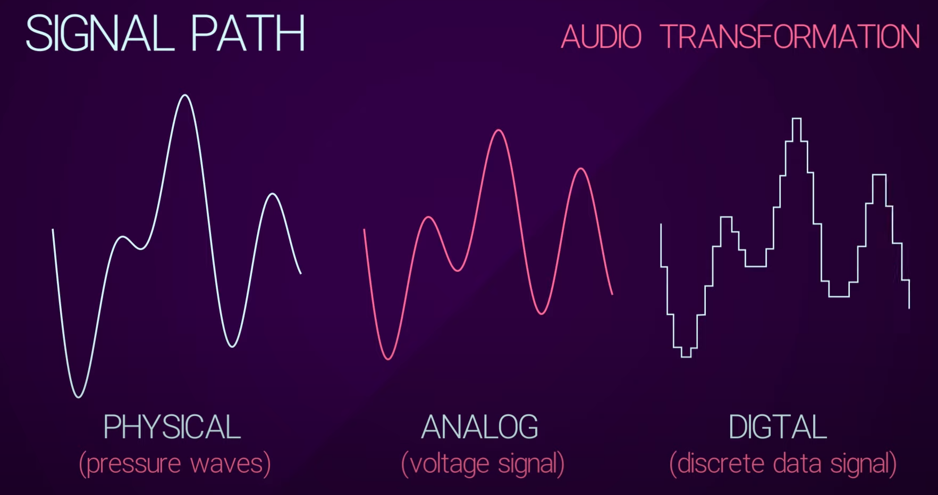
Digital Audio Fundamentals
<Signal Path>
Digital Audio Fundamentals

Slide 2
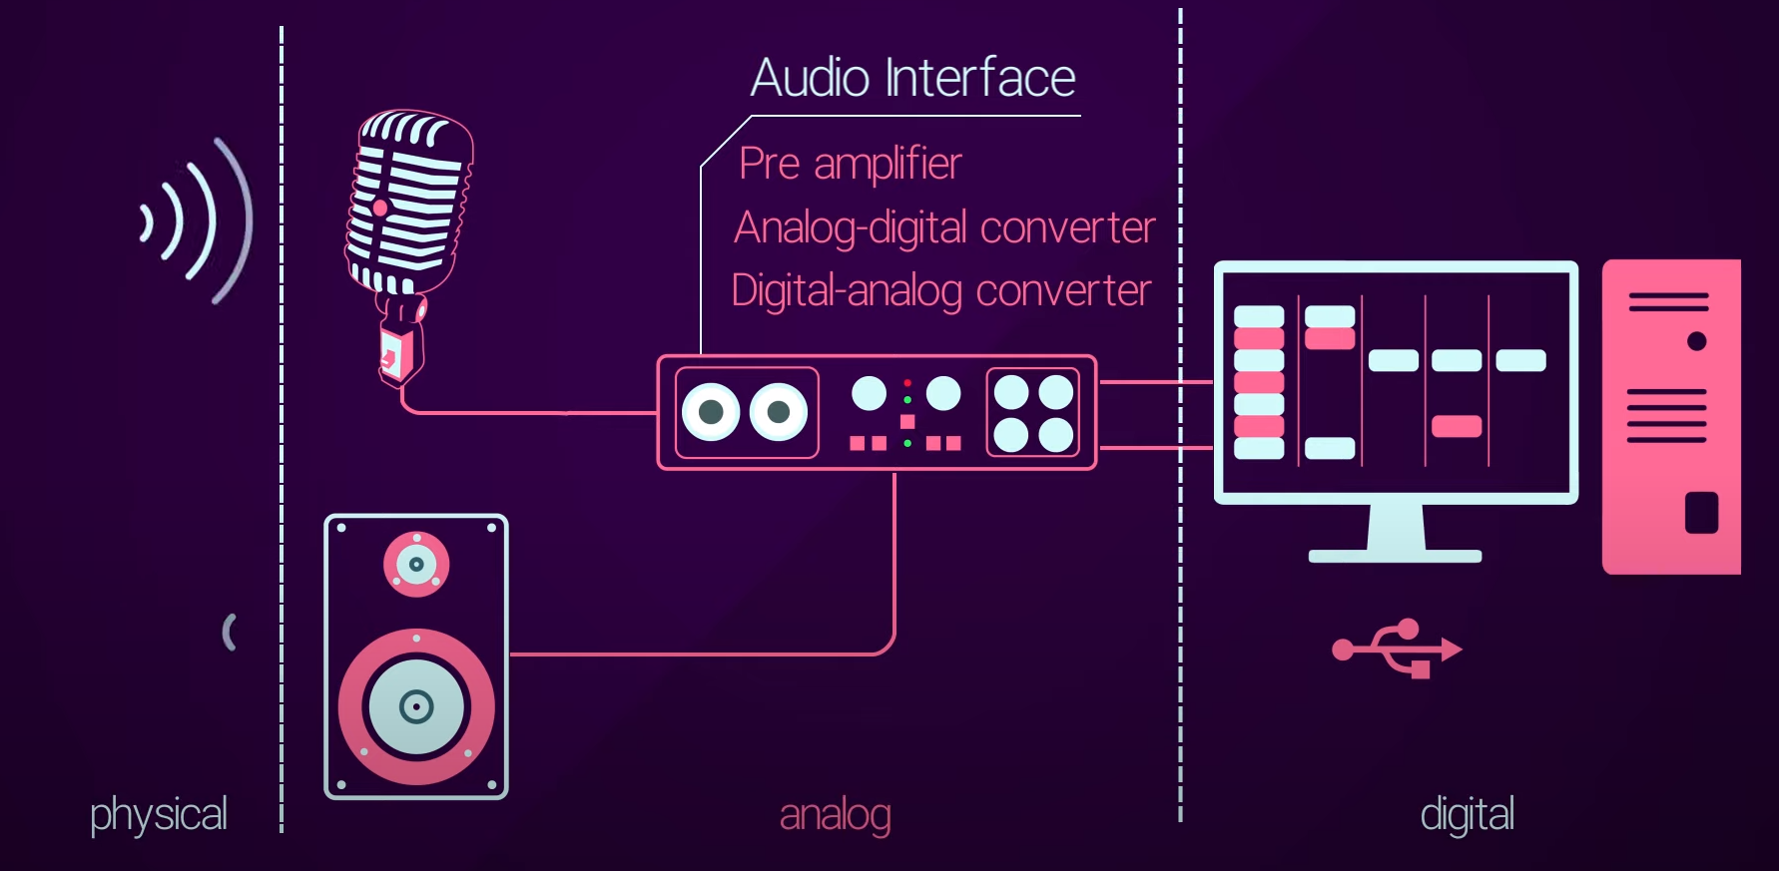
Digital Audio Fundamentals
<Signal Path>
Digital Audio Fundamentals

Slide 3
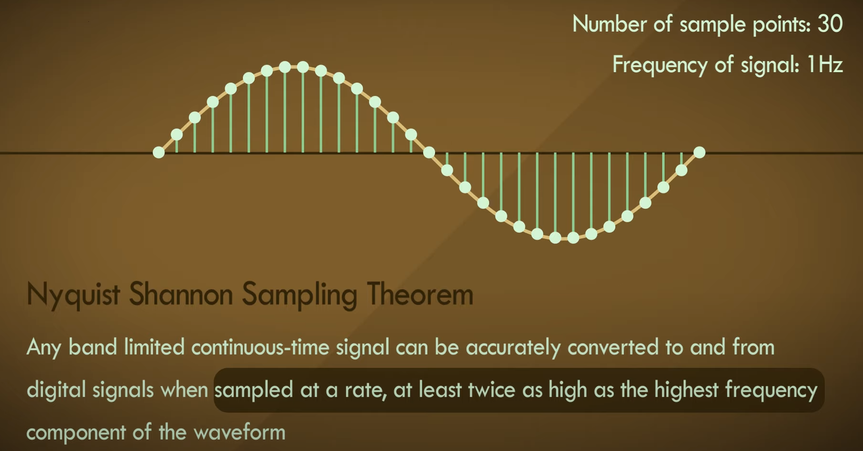
Digital Audio Fundamentals
< Sampling >
Digital Audio Fundamentals

Slide 4
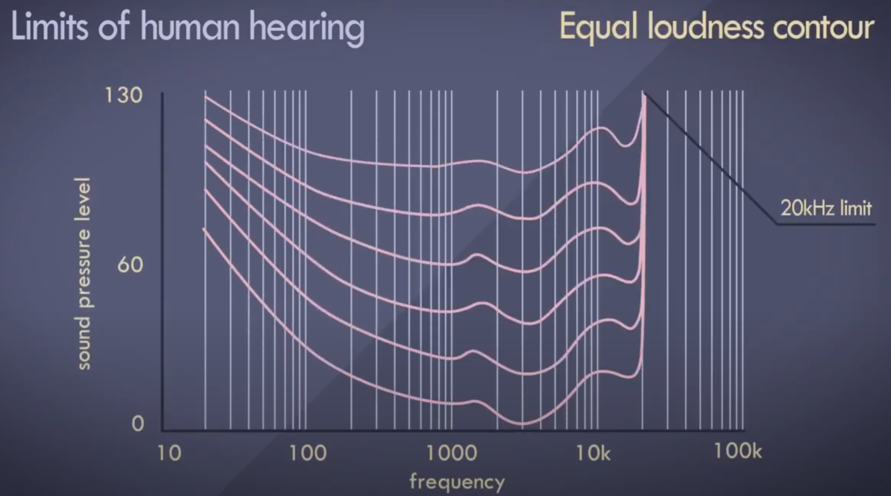
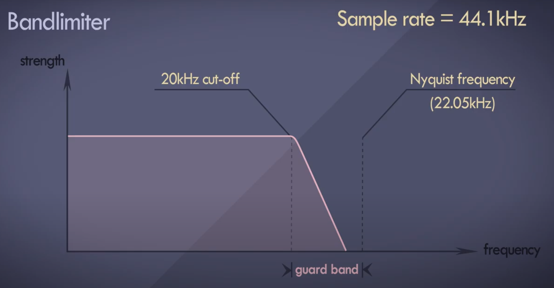
Digital Audio Fundamentals
< Sampling >
Digital Audio Fundamentals

Slide 5
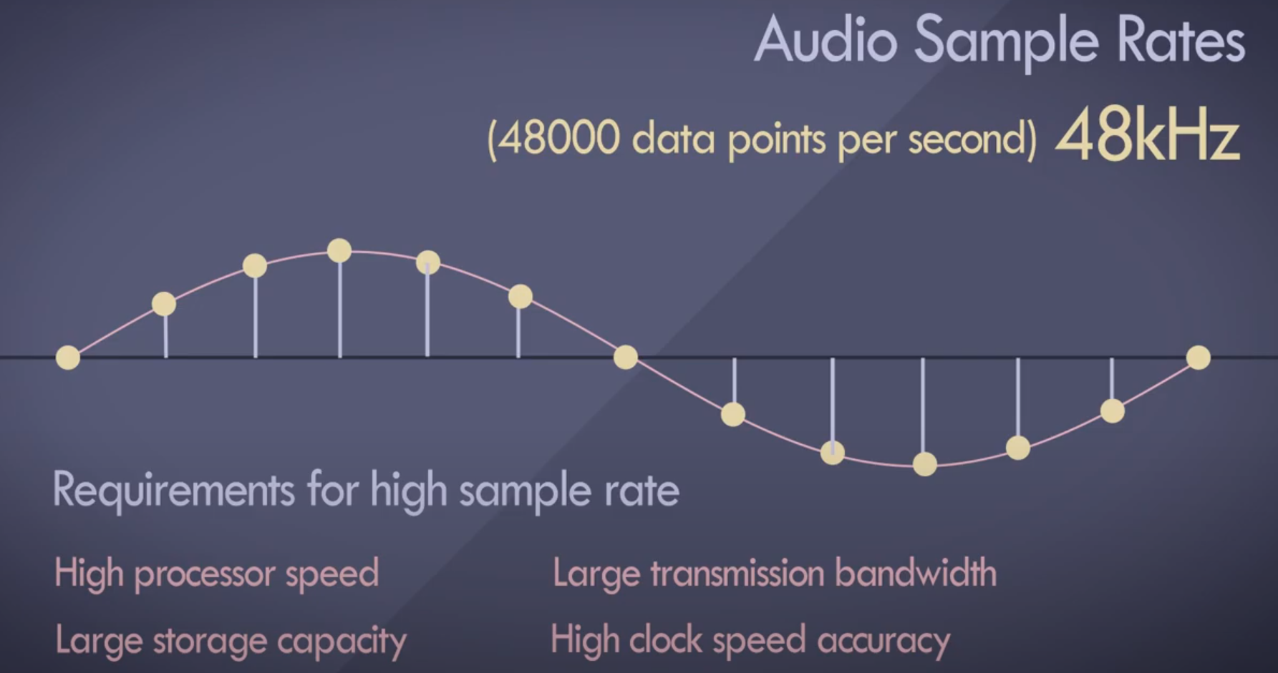
Digital Audio Fundamentals
< Sampling >
Digital Audio Fundamentals

Slide 6
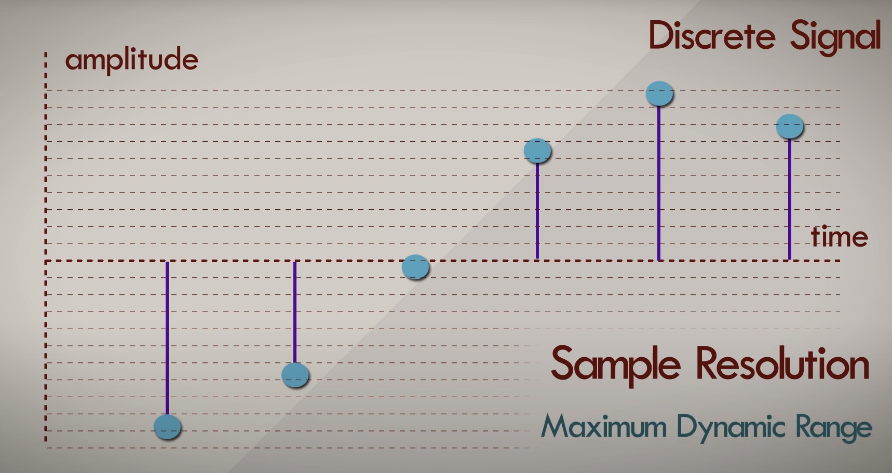
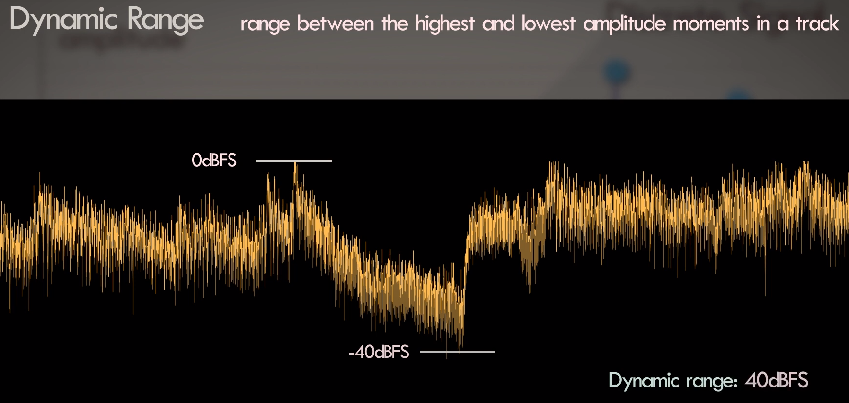
Digital Audio Fundamentals
< Quantization >

Slide 7
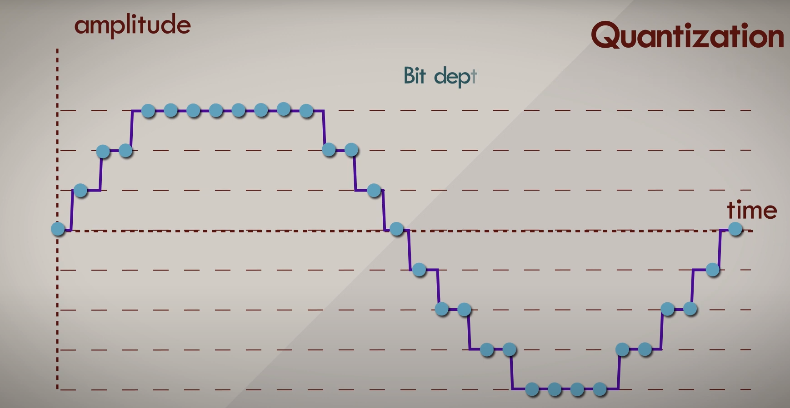
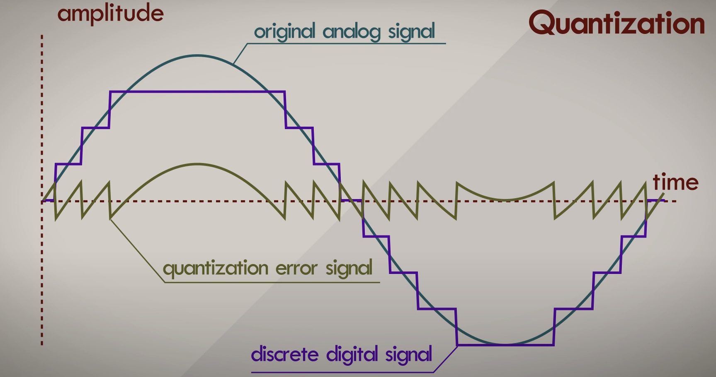
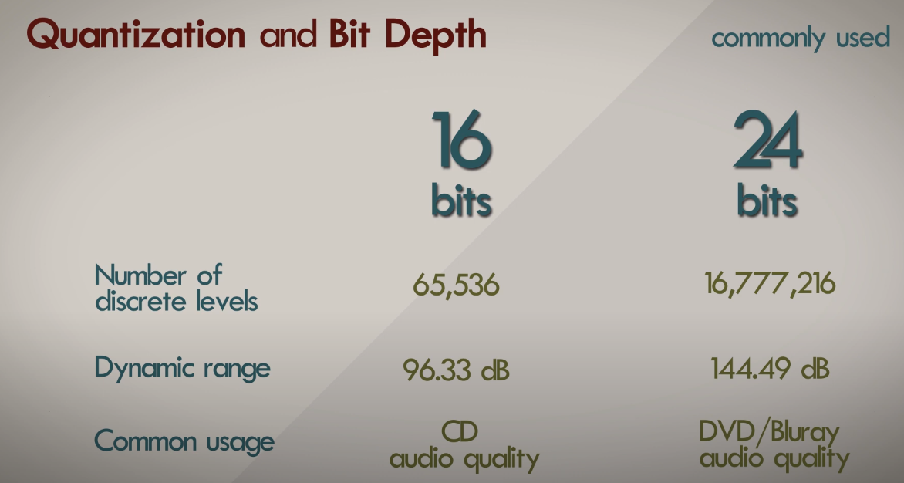
Digital Audio Fundamentals
< Quantization >
3bit Quantization Level

Slide 8
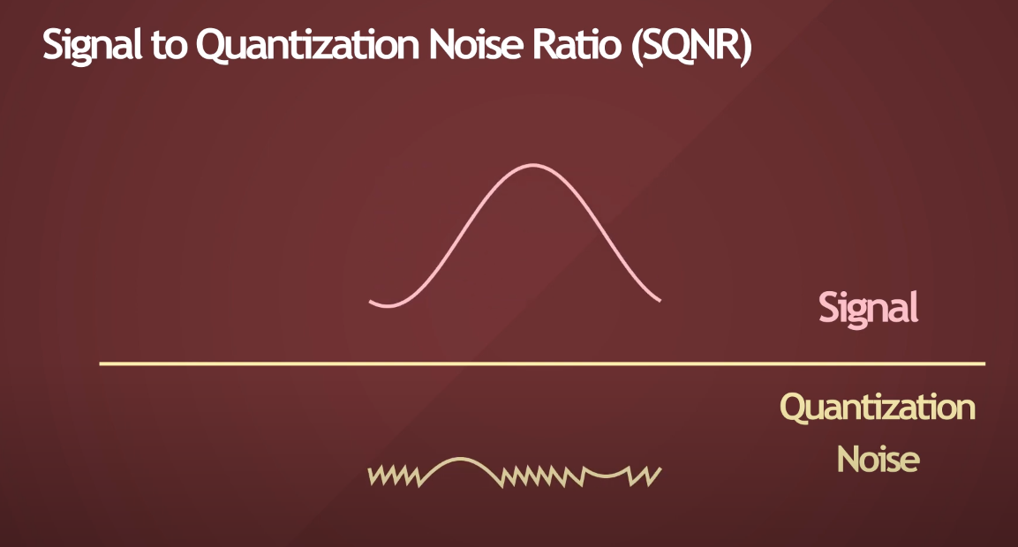
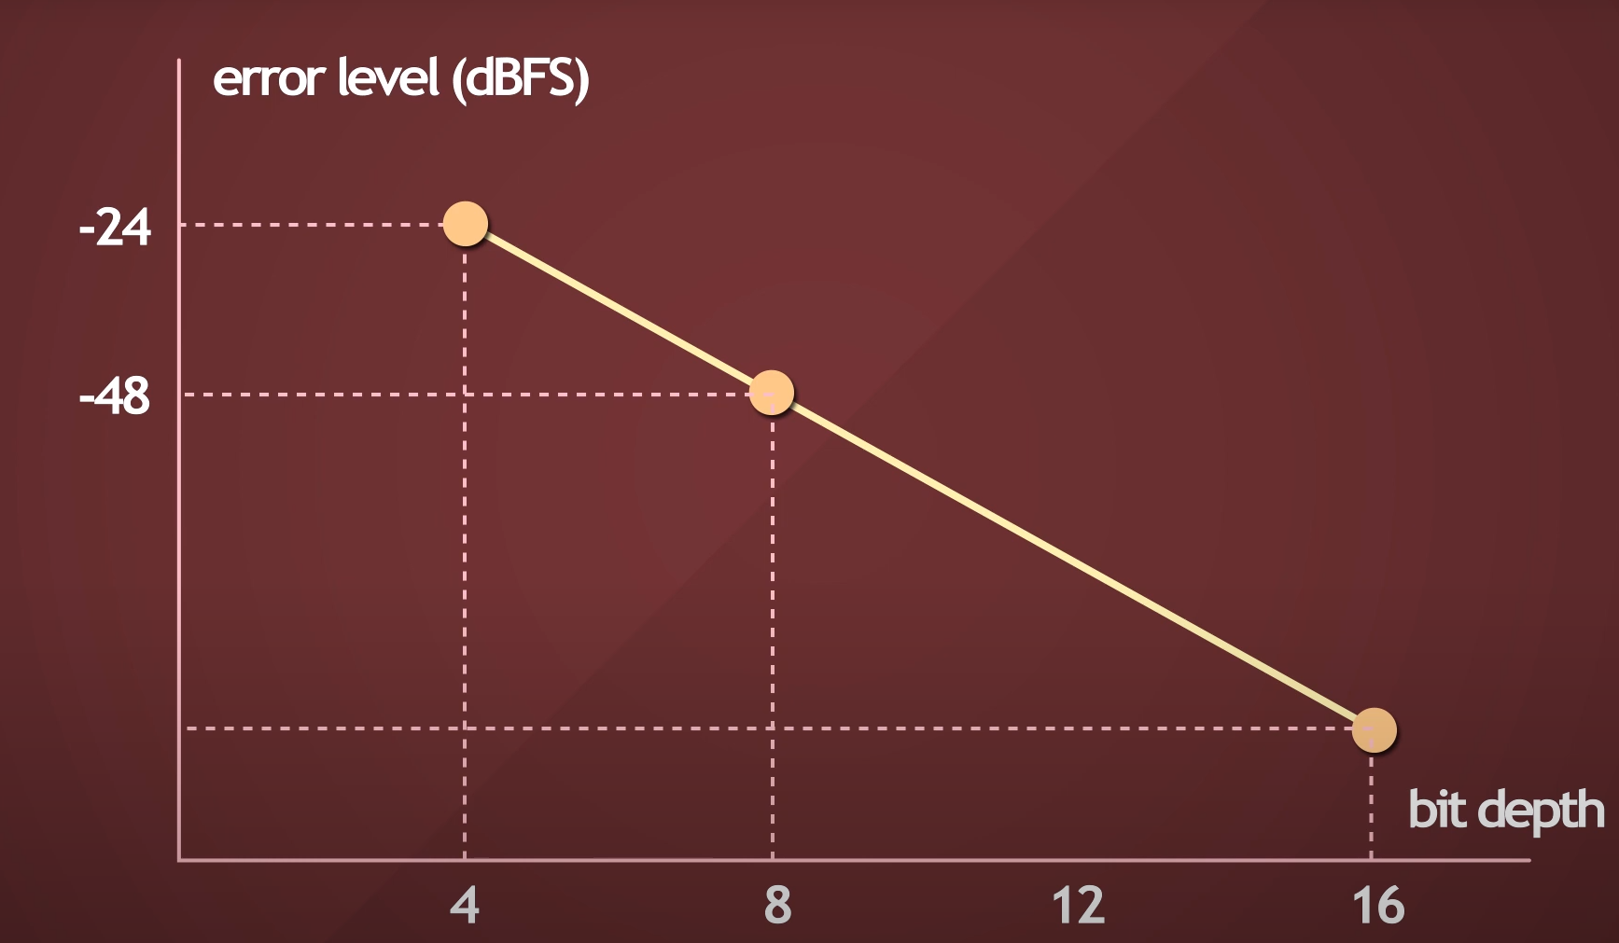
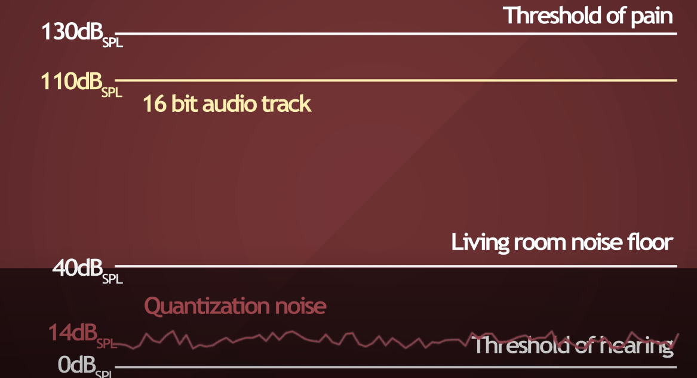
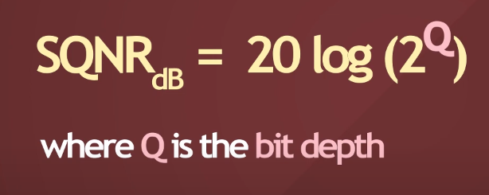
Digital Audio Fundamentals
< SQNR >

Slide 9
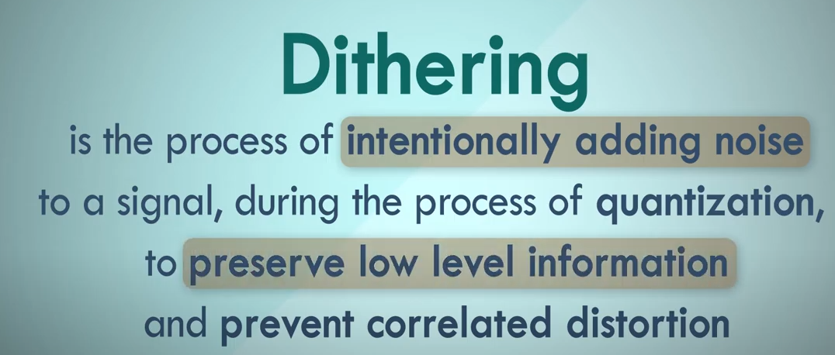
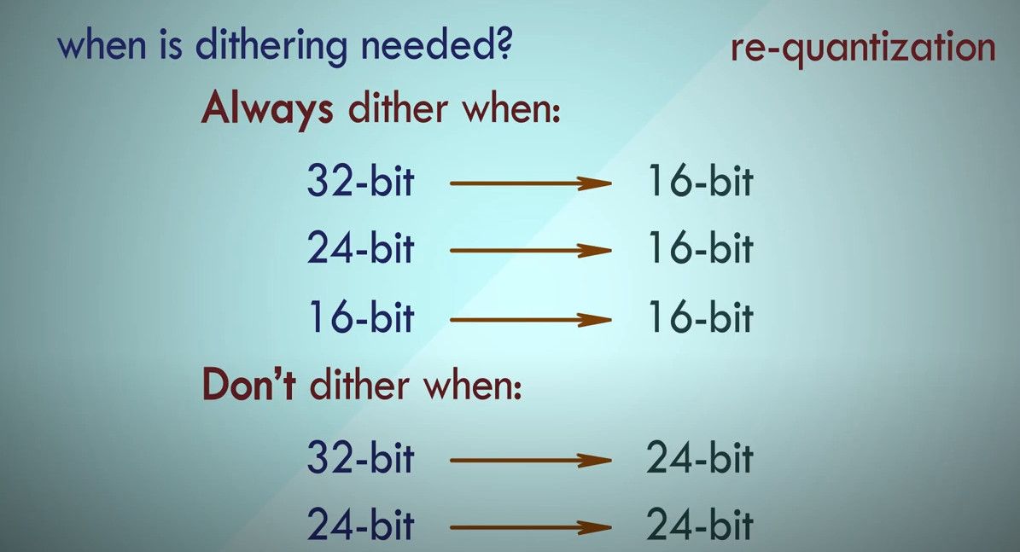
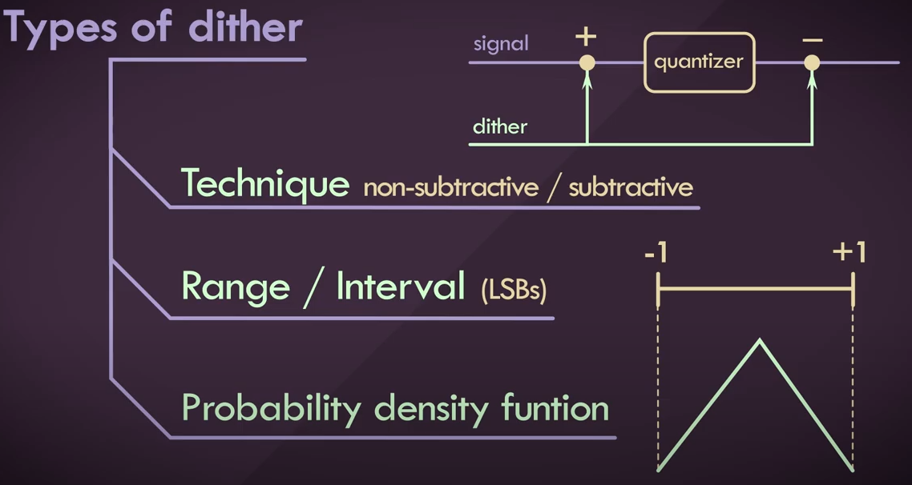
Digital Audio Fundamentals
< Dithering >

Slide 10
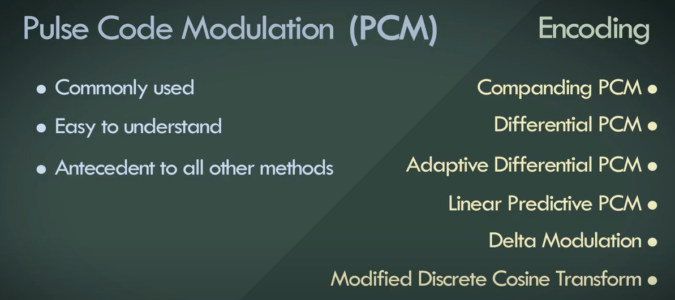
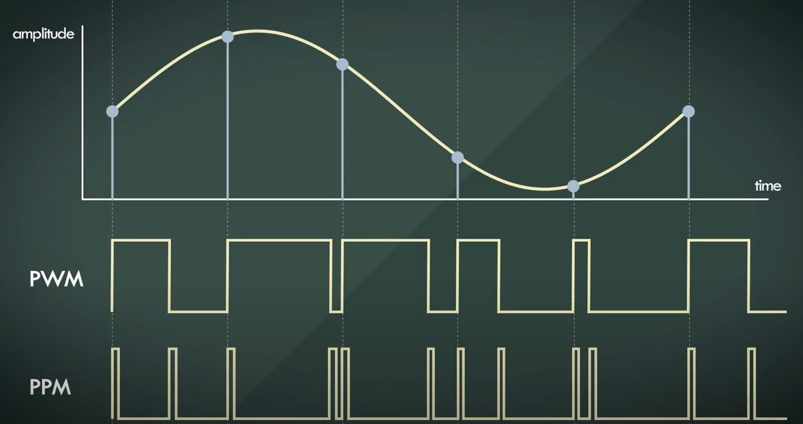
Pulse Code Modulation
< Encoding >
Frequency Modulation
Pulse Width Modulation
Pulse Position Modulation
Pulse Amplitude Modulaton

Slide 11
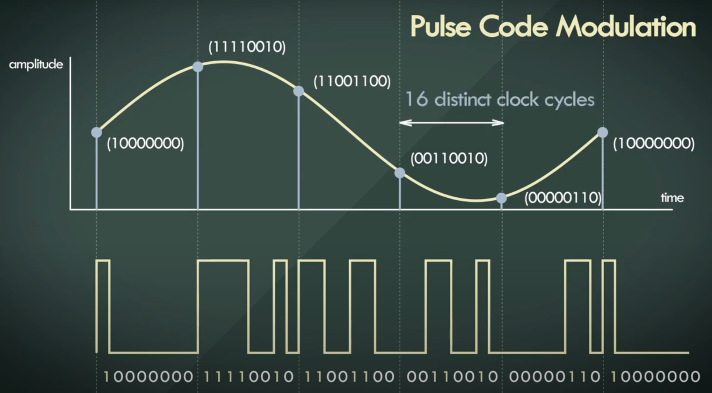
Pulse Code Modulation
< Encoding >

Slide 12
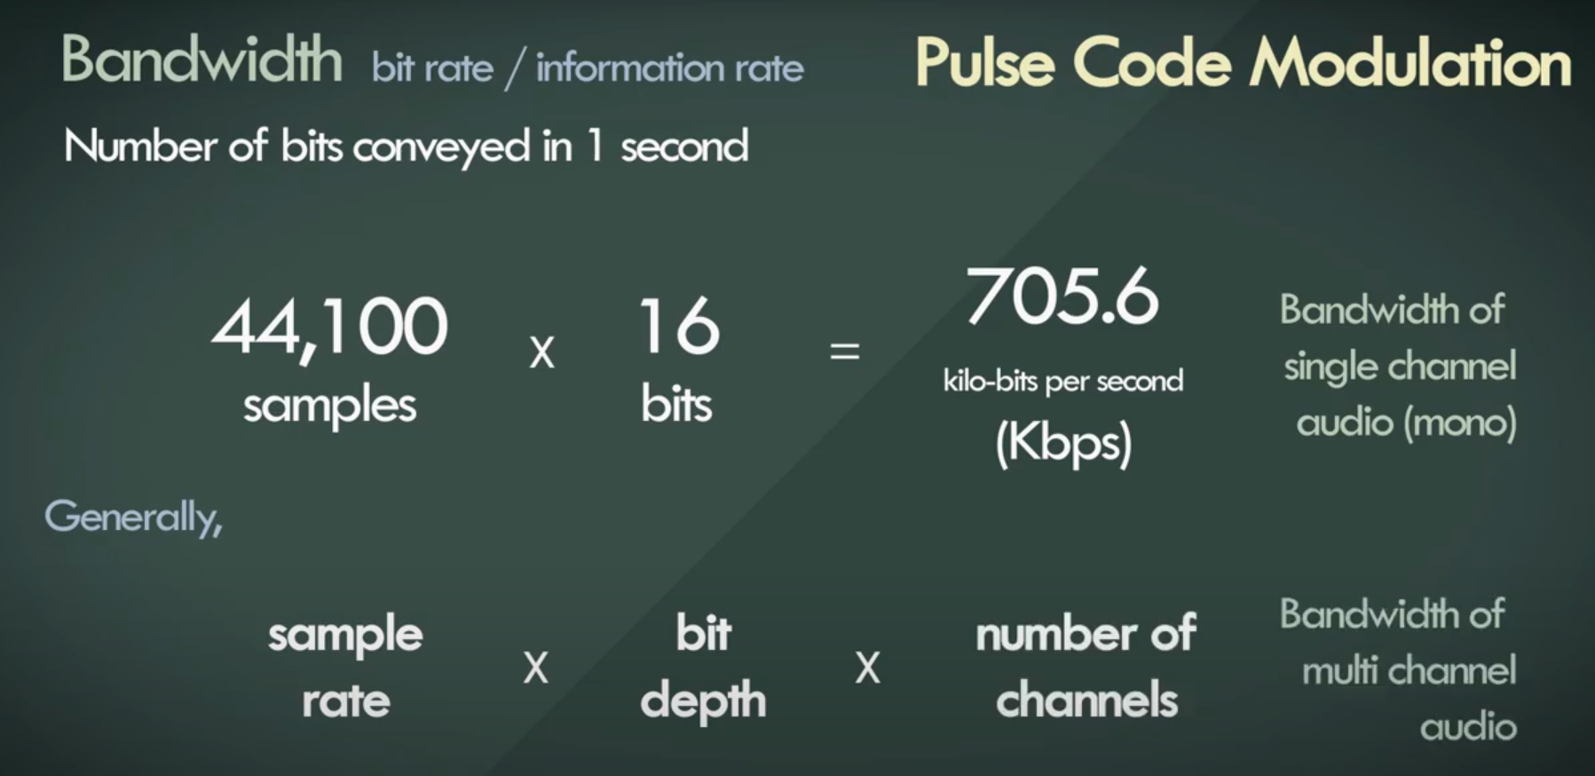
Pulse Code Modulation
< Encoding >

Slide 13
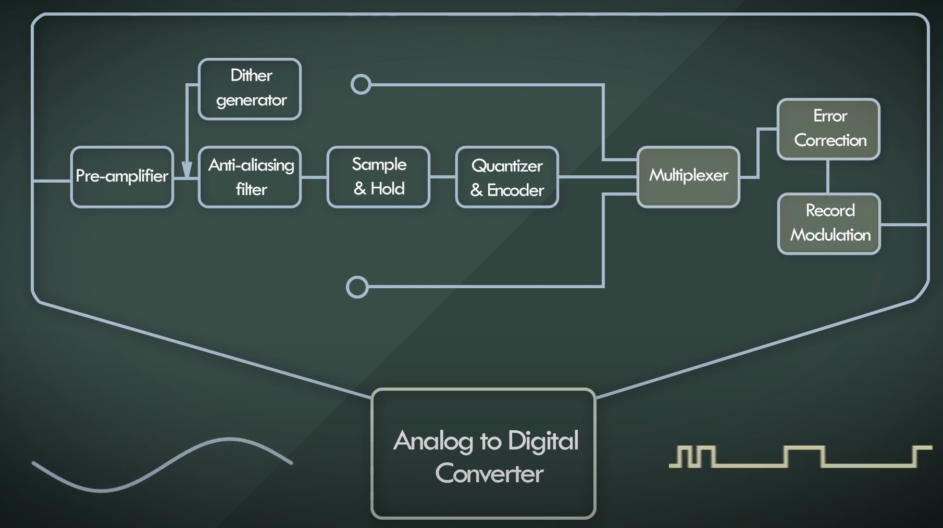
Pulse Code Modulation
< Encoding >

Slide 14
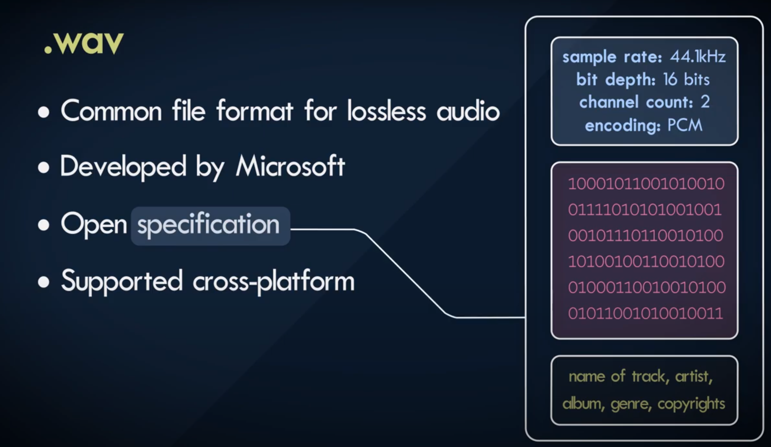
File Formats - Containers
< .wav >
.wav
.aiff
.flac
.mp3
.wma
.aac
.ogg
.m4a

Slide 15
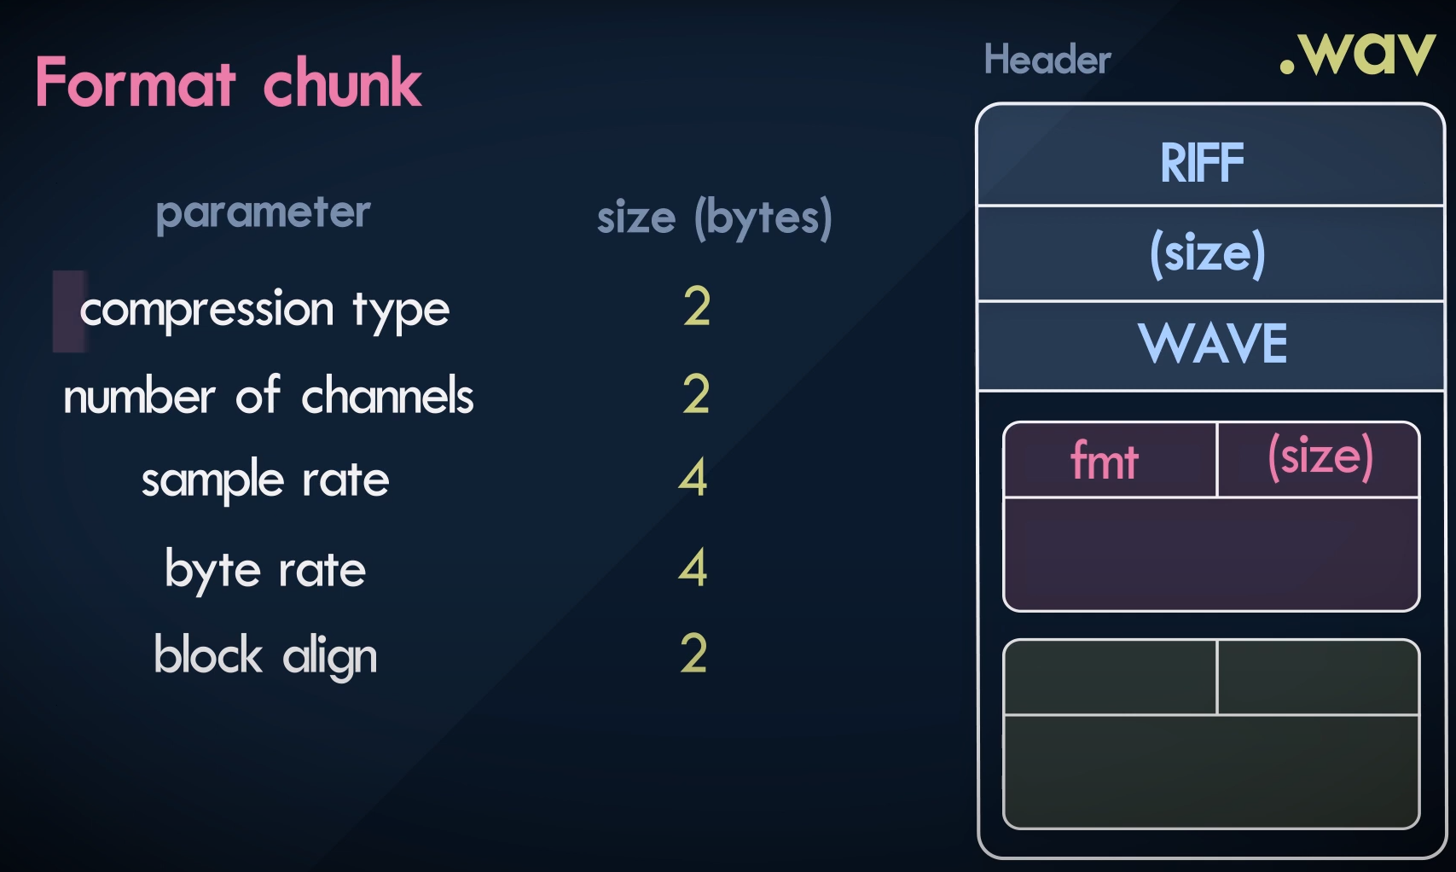
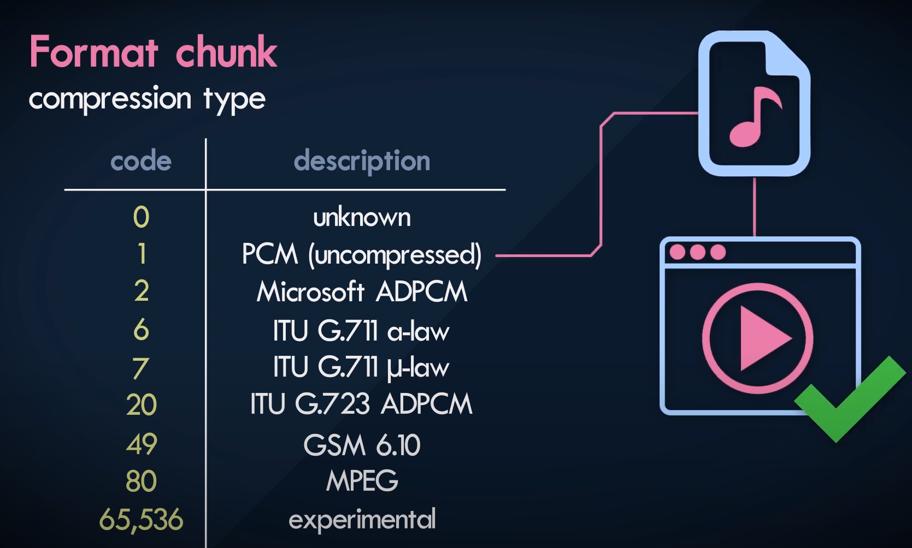
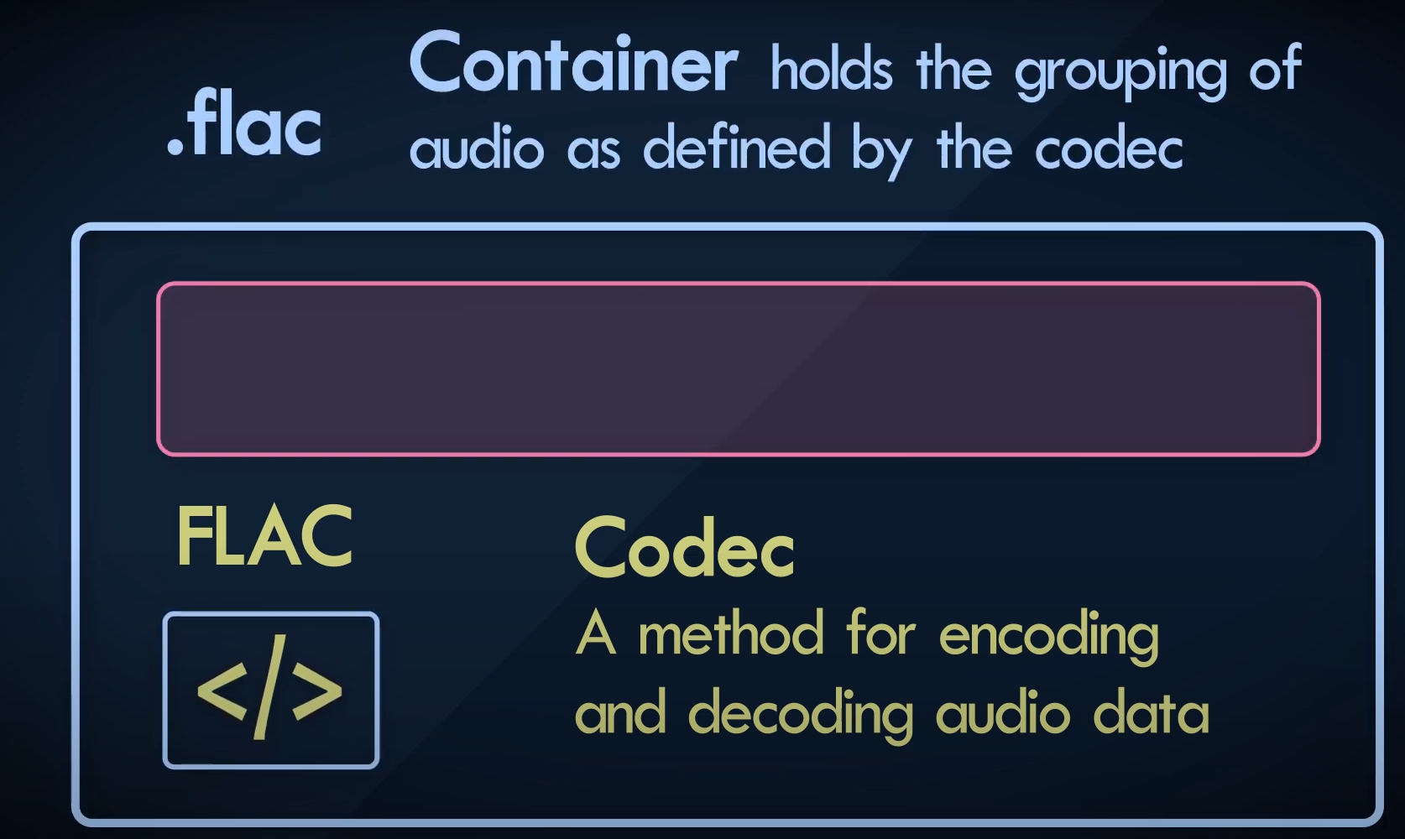
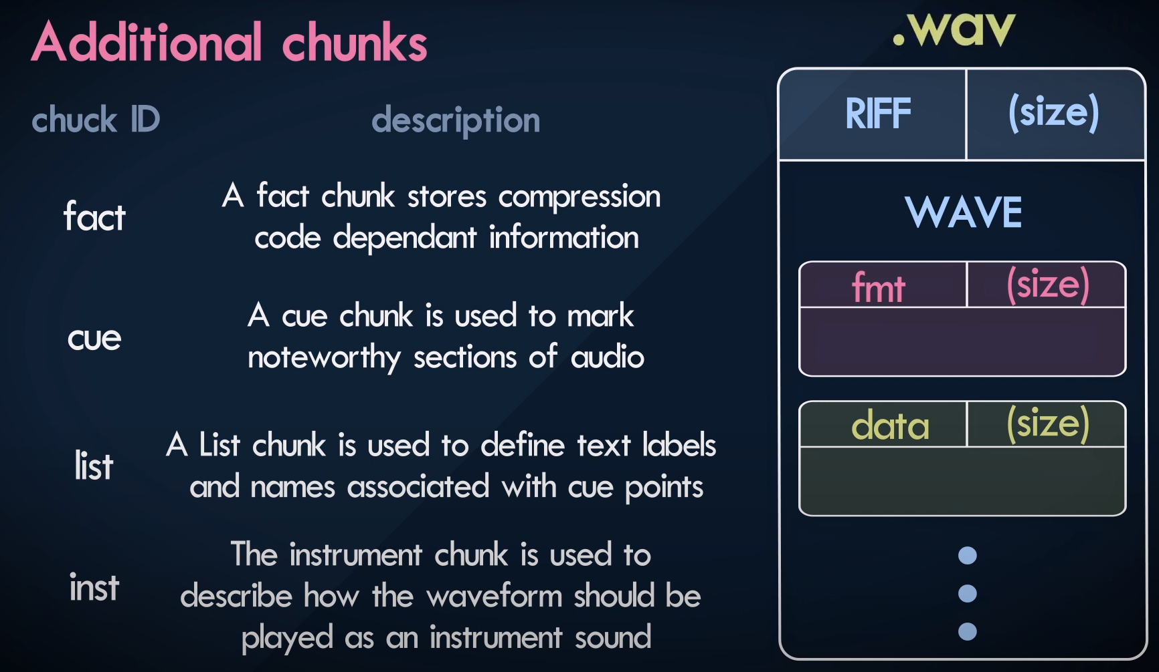
File Formats - Containers
< .wav >
Resource Interchange
File Format
Compression type

Slide 16
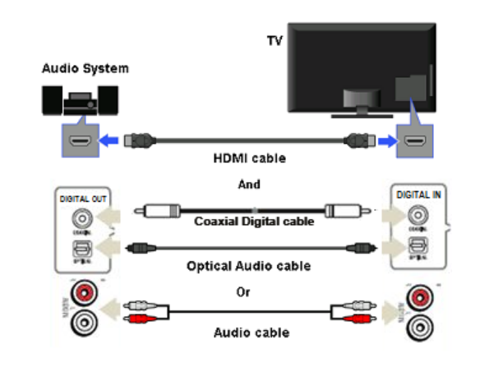
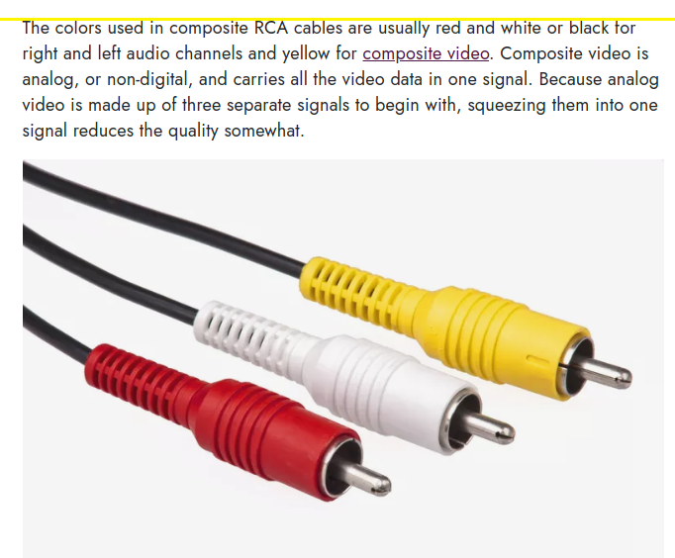
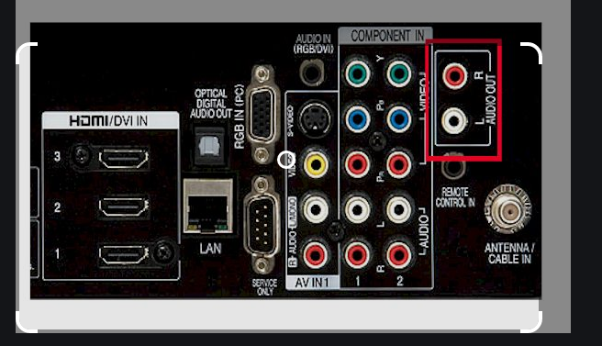
TV Audio Connections
< options >

Slide 17
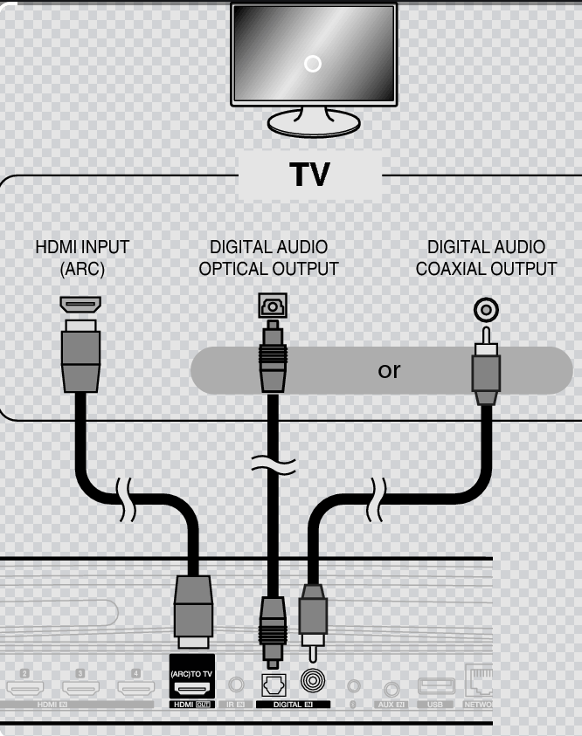
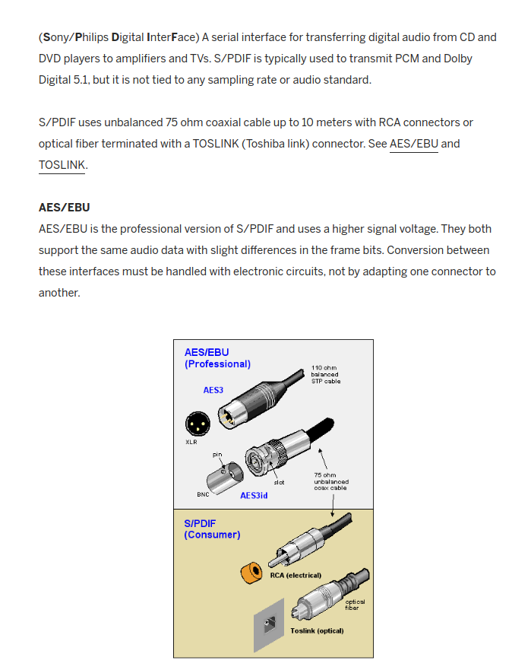
TV Audio Connections
< HDMI-ARC >
S/PDIF

Slide 18
TV Audio SOC
< Blocks >
Enhancement
MUX
Decoding – Gain etc
Filters,dtsVx,NightMod
limiter
Additional Algorithms
&
Delays
ATV Audio
MUX
Audio Amp
DTV Audio
HDMI Audio
HP
MM Audio
ARC
SPDIF
Audio Amp. General
Gains
Biquad Filters
Additional Enhancement
Gains
Speakers

